Slide 1


Beginner’s Python – Session One
The AZ Code Club Team
Blank Template
Filled Template

Slide 2


Session Content
Setting up Google Colab
Printing
Arithmetic with Python
Variables and variable typing

Slide 3

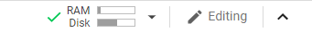
Using Google Colab
Colab is an interactive editor for Python in the cloud
To get started, open Google Colab in Chrome
Sign in using your personal Google account
Click ‘New Python Notebook’ or, if this is not an option, ‘File > New Python Notebook’
Top right hand corner should look like this
If not, click ‘connect’

Slide 4
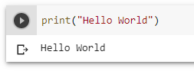
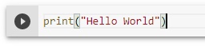
Using Google Colab
We run code in Google Colab by typing it in a code ‘cell’ and clicking the play button
Try the example above. We’ll explain what we wrote in one moment.
Bonus: You can also run the contents of a cell using `ctrl+enter`

Slide 5
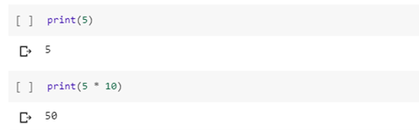
Printing
Printing allows Python to talk to us. In the last example we used printing to make Python say “Hello World”
We can make Python say anything by writing a sentence, wrapped in double quotes, and passing it as the input to print(…)
The print function can also be used to perform arithmetic. Just replace the input to of the print() with the expression you want to evaluate
Note, in this case, we don’t need quotes. They were only to let Python know that the input to print(…) was text

Slide 6
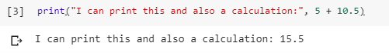
Printing
You can print multiple things (which will be automatically separated by spaces) by passing more than one input to print(…)
We separate each input using a comma
As we can see above, Python is happy to combine both text (using double quotes) and arithmetic (no need for double quotes here

Slide 7
Printing Puzzles
Print your name using the print() command
Print your three favourite colours by passing them as three separate inputs to print() (remember: separate each input with a comma)
Calculate 26, multiplied by 66, add 13
Calculate 6804 divided by 162 (hint: use / for division)
Bonus: Calculate 2 to the power of 8 (hint: use **)
Bonus: What happens if you put a mathematical expression in double quotes when you are printing it?
Super Bonus: Google ‘python integer division’ and repeat the above division using this

Slide 8
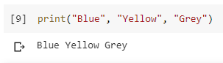
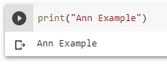
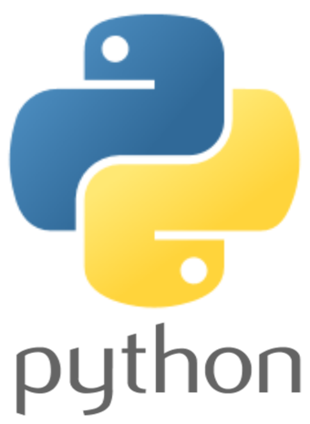
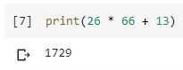
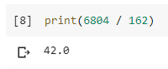
Printing Puzzles Solutions
Note: you can find solutions to the bonus puzzles here

Slide 9
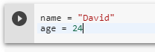
Variables
Variables let you hold information to be used later in your code
A variable is essentially a way of naming a particular value so we can reference it later
We assign a value to a variable using the equals symbol
Here we made two variables called ‘name’ and ‘age’ with the values “David” and 24, respectively
Once you’ve created a variable it will continue to exist until you either delete it or close your browser

Slide 10
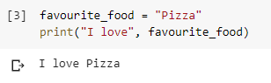
Variables
Once we have assigned a variable a value, we can use it in our code by simply typing its name
When Python sees `favourite_food` in the above example, it remembers the last time `favourite_food` was assigned a value and replaces it with this value
Note, when we use variables, we don’t write their name in quotes. Otherwise Python will just print their name without replacing it with the corresponding value

Slide 11
Variables Puzzles
Create two variables called ‘name’ and ‘age’, giving them the value of your name and age respectively
Get Python to print these in the following format:
Hi, my name is David and I am 24
Bonus: Print what your age will be in 5 years’ time
Super Bonus: Create a variable whose value is any number. Print that number, twice the number, and one less than the number. Now change the number. How did using variables make this process easier?

Slide 12
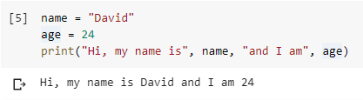
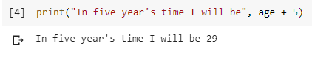
Variables Puzzles Solutions

Slide 13
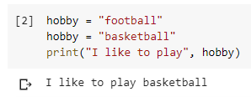
Manipulating Variables
Python will only remember the last value that you assigned to a variable
The act of giving a variable a new value is known as overwriting
Pay attention to the bracketed numbers next to code cells. These show which order cells were run in (which doesn’t have to be top to bottom!)

Slide 14
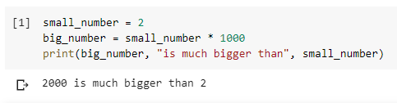
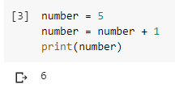
Manipulating Variables
You can define a new variable by manipulating the value of an existing variable
You can even replace the current value of a variable with a new value based on the old one. This is known as overwriting the variable. Be careful: this can make your code confusing!

Slide 15
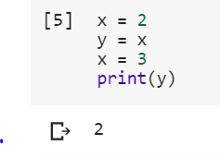
Manipulating Variables Puzzles
Run the following lines of code:
What do you think the output of this will be?

Slide 16
Manipulating Variables Puzzles Solutions
Not what you expected? Remember: the equals symbol in Python means ‘assign the value on the right to the variable on the left’. It has nothing to do with the equals symbol in maths.
Here, the third line says ‘assign the variable `y` the value of the variable `x`’. When Python sees `x` it remembers that it has a value of 2 so this becomes `y = 2`
Changing `x` after makes no difference since the last value `y` was set to was `2`, regardless

Slide 17
Variable Types
There are different types of variable in Python. Some we have seen:
Strings (e.g. “Hello”)—text in quotes, called strings because they are a string of characters
Integers (e.g. 4)
Floats (e.g. 3.14)—decimal numbers, called floats due to how Python stores them (Google ‘floating-point arithmetic’ if curious)
There are many types that we haven’t come across (yet!):
Booleans (True/False)
Lists/Tuples/Sets
Dictionaries

Slide 18
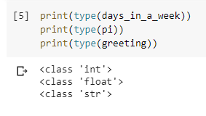
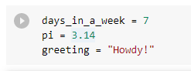
Variable Types
We can examine the type of a variable by passing it as the input to the type() function and then wrapping this in print to show the result
Bonus: what happens if we ignore the print() function and just run type(days_in_a_week)?

Slide 19
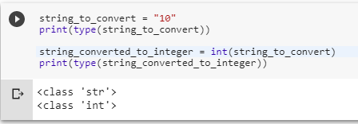
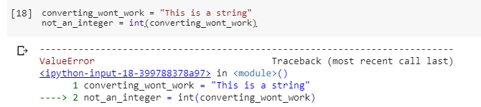
Variable Types
You can use the functions int(), float(), and str() to convert between types
…provided that it is possible to make a conversion. Otherwise you’ll get an error

Slide 20
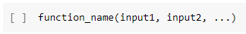
Aside: Functions
We keep on using this word ‘function’—what does it mean?
A function is essentially a command you can tell Python to follow
They always follow the following format:
That is, a function name (which almost always starts with a lowercase letter) followed by a pair of brackets which we fill with inputs separated by commas
print(), type(), int(), float(), and str() are all functions

Slide 21
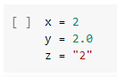
Variable Types Puzzles
Define the following variables
What types do you think they will each have? Check!
Create two string variables. What happens when we add them together using `+` and print the result?
Bonus: What happens when we multiply a string by an integer?

Slide 22
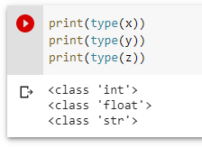
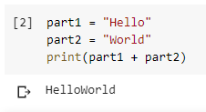
Variable Types Puzzles Solutions

Slide 23

More Variable Puzzles
Create a variable `pi` with the value 3.14 and a variable `radius` with any value of your choosing
Use these to print the circumference and area of a circle with radius equal to the value of `radius`
You may need the following formulae:
Bonus: use the round() function to round your answer to 2 decimal places. This takes to inputs, a number to round and the number of decimal places to round to (separated by a comma, remember!)
$$Area=π×r×r$$
$$Circumference=2×π×r$$

Slide 24
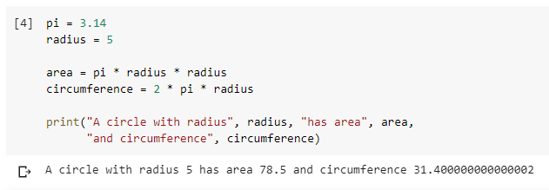
More Variable Puzzles Solutions
Note, in most cases, Python ignores extra spaces and new lines
Therefore we can go onto a new line after printing area without changing how Python executes the code. It just makes it easier for us to read!

Slide 25
Next Time
Accepting user input
More variable typing
Storing lists of numbers
Finding the total, length, min and max of a list
See you then!

